Slide 1
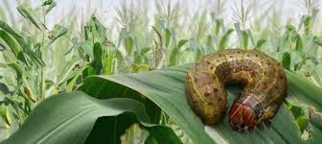
Fall Armyworm Maize Crop Project
Presenter: Mr Mashele G.P

Slide 2
AGENDA
1. PROBLEM STATEMENT
2. OBJECTIVE
3. DATA DESCRIPTION
4. METHODOLOGY
4.1 Feature/Image Extraction
4.2 Image pre-processing
4.3 Model Architecture
4.4 Model building & breakdown
5. MODEL PERFORMANCE EVALUATION
6. MODEL PREDICTION
7. KEY FINDINGS
8. Q&A

Slide 3
1. PROBLEM STATEMENT
Fall armyworm is a devastating pest in Africa, where it has no natural predators
African farmers say the pest causes average maize losses of 31% annually. Maize is the most widely grown crop in Africa and a staple for around half the continent’s people
Over 300 million Africans depend on the crop for food and nutritional security. For smallholder farmers in particular, maize is popular for its wide adaptability, valuable by-products and high yields.
Because of this reliance on staple crops for food security, viral pests and diseases like fall armyworm are one of the leading causes of food insecurity and poverty in Africa. Thus there is an urgent need to design early intervention mechanisms to help prevent crop losses for smallholder farmers.

Slide 4
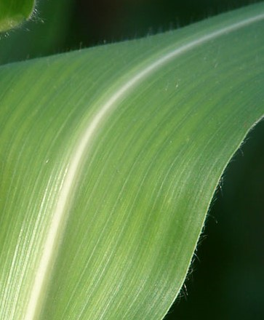

2. OBJECTIVE
The aim of the project is to classify if a plant has been affected by a fall armyworm or not.
This is a binary classification(supervised learning technique) challenge that needs to be looked in assisting smallholder farmers in Uganda and the rest of Africa in order to carry out field-based diagnosis and intervene before fall armyworm devastates their maize crop for the season.
Given the maize crop images, we need to build a model that will determine if maize crops have been affected by the fall armyworm pest using binary classification of 0 or 1. where
0 : indicate that the image/maize crop is not affected by fall armyworm.
1: the image is affected by a fall armyworm
Le

Slide 5

3. DATA DESCRIPTION
The dataset contains images of maize crop leaves collected by research scientists from the Makerere Artificial Intelligence Lab, the Marconi Machine Learning Lab, and the National Crops Research Institute in Uganda.
About Makerere University Research
Innovations Fund (RIF)(https://rif.mak.ac.ug/)
Makerere University is a research initiative of netLabs in UG, Makerere University that focuses on machine learning research in diverse areas including Agriculture, Health and Natural Language Processing.
The downloaded dataset contain three files namely train set with Image IDs and Labels(0 &1) , test set with Image IDs and Image Zip folder with Images for training and testing.
It contains 2699 images equally distributed across the healthy and fall armyworm classes.
Le

Slide 6
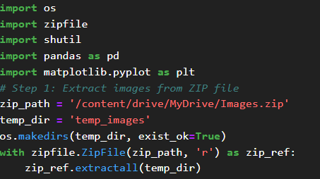
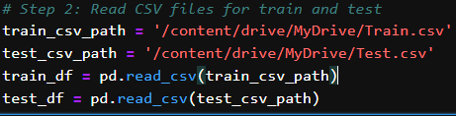
4. METHODOLOGY: FEATURE EXTRACTION
1. Extract image Zip file from my drive on google colab
2. Read the train and test csv files with Image IDs & labels
by first creating the file path:
Le

Slide 7
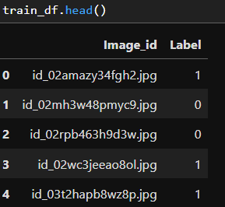
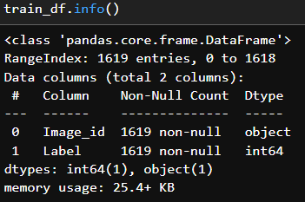
4. METHODOLOGY: FEATURE EXTRACTION
3. Display the first five rows and data types info on the training set
Observation: The train set consist of 1619 entries with Image IDs and Labels columns (with binary of 0 &1)
0 : Image not affected by fall armyworm
1: Image affected by fall armyworm
Le

Slide 8
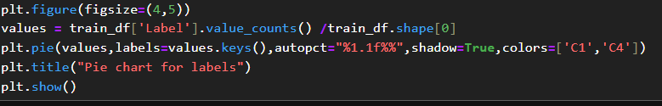
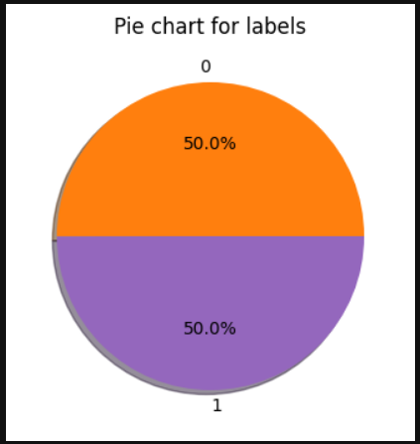
4. METHODOLOGY: FEATURE EXTRACTION
4. Pie chart to display the percentage of maize crop affected by pesticide(Fall Armyworm) or not.
Observation: The label for image in the training set are equally distributed across the healthy and unhealthy (fall armyworm) classes
Le

Slide 9
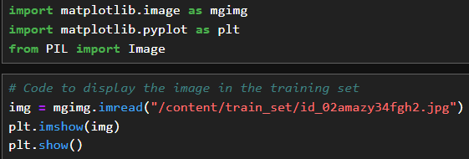

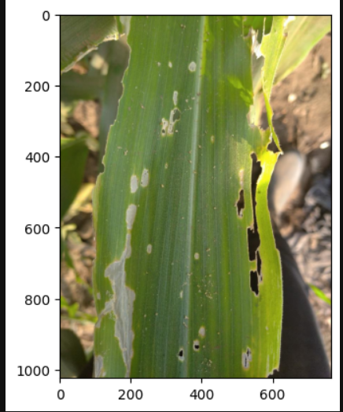
4. METHODOLOGY:IMAGE PREPROCESSING
1. Splitting the extracted Image Zip file according to the ImageIDs in the train and test csv file, store the images in the new train and test directory and after we rescale and split the new train set into train and validation set using DataImageGenerator library
2. Display one Image file in the train set with the corresponding train set info to confirm the labels with the Image.
Le
Observation:
The image_id and Label used correspond with the Image affected by fall armyworm.

Slide 10
4. METHODOLOGY :Model Architecture
The aim of the project is to determine if maize crops have been affected by the fall armyworm pest or not using Images.
This is a binary image classification task that requires a convolutional neural networks (CNNs) , a Sequential model that makes prediction/classification based on convolutional layers.
The CNNs model architecture is designed for image classification tasks. It starts with convolutional layers to learn local features from the input images, then applies pooling layers to reduce dimensionality and prevent overfitting. The model flattens the output and passes it through dense layers to learn global patterns and finally outputs a probability distribution over classes.
Le

Slide 11
4. Methodology :Model Building and Breakdown
Input Layer: Use 2D convolutional layer with 32 filters, each of size 3x3, Input shape specify the input images of shape (150, 150, 3), meaning 150 pixels wide, 150 pixels tall/height, and 3 color channels (RGB) and activation function –RELU(Rectified Linear unit) which impose non-linearity in the model.
Convolutional Layers
MaxPooling2D((2, 2)): After the first convolutional layer, a max pooling layer is applied. This layer reduces the spatial dimensions (width and height) of the output volume by taking the maximum value in a window of size 2x2 over the input volume. This helps in reducing the computational complexity and preventing overfitting.
Conv2D(64, (3, 3), activation='relu'): The next convolutional layer has 64 filters of size 3x3, with RELU activation function. Another MaxPooling2D((2, 2)) layer follows, further reducing the spatial dimensions.

Slide 12
4.Methodology:Model Building &Breakdown(Cont.)
Final Convolutional Layer
Conv2D(64, (3, 3), activation='relu'): This is another convolutional layer with 64 filters,using the ReLU activation function.
Flattening Layer
Flatten(): After extracting features through convolutional and pooling layers, the output is flattened into a one-dimensional array.
Dense Layers
Dense(64, activation='relu'): The first dense layer has 64 neurons and uses the ReLU activation function.
Dense(1, activation='sigmoid'): The final dense layer outputs a single value per image, representing the probability that the image belongs to a certain class, using sigmoid activation function.

Slide 13
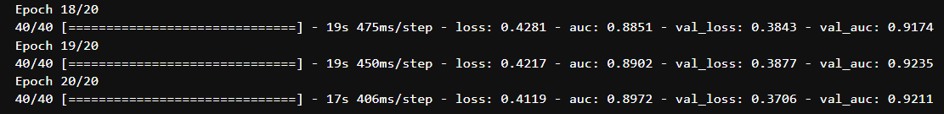
5. Model Performance Evaluation
Model is built & compiled using the following parameters
Optimizer: Stochastic gradient descent(SGD)
Loss function: binary-cross entropy
Performance metrics: Area under the curve(AUC)
Model performance after training the model using the train and validation set for 20 Epochs/Iterations.
Observation: After 20 Iterations , the model resulted to Area under the curve of 89.72% in the training and 92.11% in the validation.
The model is performing well and can be used for prediction.

Slide 14

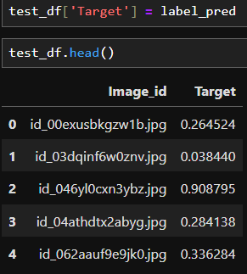
6. Model Prediction
Model prediction on test generator set/unseen data.
Data frame of the first five predicted labels.
Observation: The Image with ID ‘id_046yl0cxn3ybz.jpg’ predicted a probability of 0.908795, which means that the image is the only one among the five, affected by fall armyworm since the probability is nearer/closer to 1

Slide 15

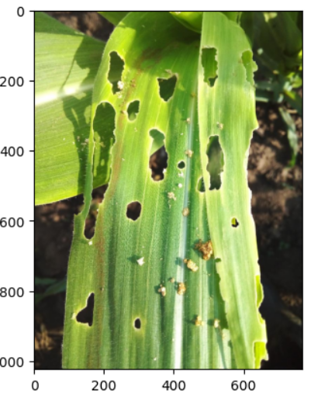


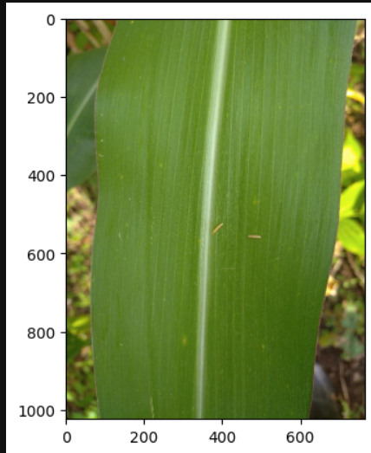
6. Model Prediction
The model makes correct predictions as evidenced by the images and imageIDs shown with their associated probabilities. The image with ID ‘id_00exusbkgzw1b.jpg’ predicted a probability of 0.264524, which indicate that the crop is healthy as compared to the other image with probability of 0.908795(affected by fall army worm)

Slide 16
7. Key findings
The Makerere Fall Armyworm Project contains 2699 images which are equally distributed across the healthy and fall armyworm classes.
1619 images are used for training and 1080 used for testing.
The training set contains two columns, namely the ImageIDs and Label (as target variable as binary of 0 &1).
This is a Binary Image Classification Tasks designed for Convolution Neutral Network(CNNs).
The CNN model is build with multiple layers ( input ,convolutional, flattening & dense layers ) that constitute activation functions such as RELU(Rectified Linear Unit) and Sigmoid.
Area under the curve(AUC) performance metrics for classification is used for model performance
After 20 iterations on CNN model with hyper-parametric tuning, the model resulted to a remarkable AUC score of 89.72% in the training and 92.11% in the testing

Slide 17
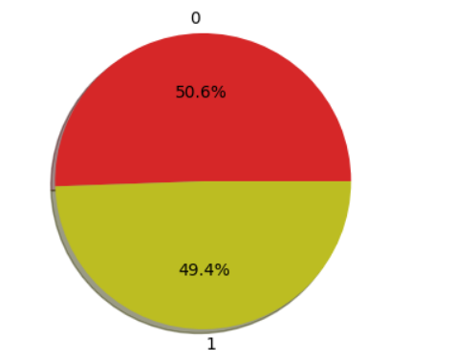
7. Key findings(Cont..)
The model predicted 50.6% of healthy crops & 49.4% of those affected by the fall armyworm as shown in the figure below.
Pie chart for Makerere Fall Armyworm.

Slide 18
8. Fall Armyworm Maize Crop Project
Q &A

Slide 19
Fall Armyworm Maize Crop Project
THANK YOU

